Slide 1


Understanding A Website
Full-Stack Web Development Bootcamp

Slide 2

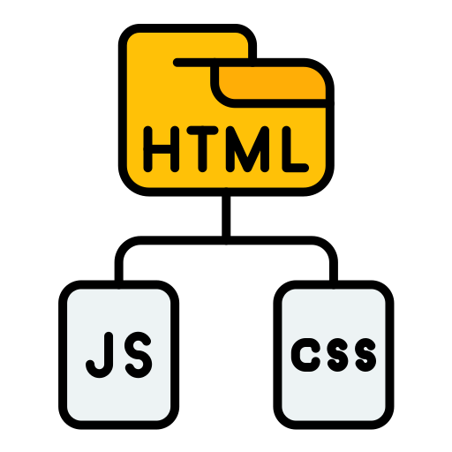
Additional Files With HTML
HTML – Hyper Text Markup Language
HTML (Hypertext Markup Language) is the standard language for structuring and displaying content on web pages.
CSS – Cascading Style Sheets
CSS (Cascading Style Sheets) is a language used to style and layout web pages, controlling design elements like colors, fonts, and spacing.
JavaScript
JavaScript is a programming language that enables dynamic, interactive features on websites, such as animations, form validation, and real-time content updates.

Slide 3
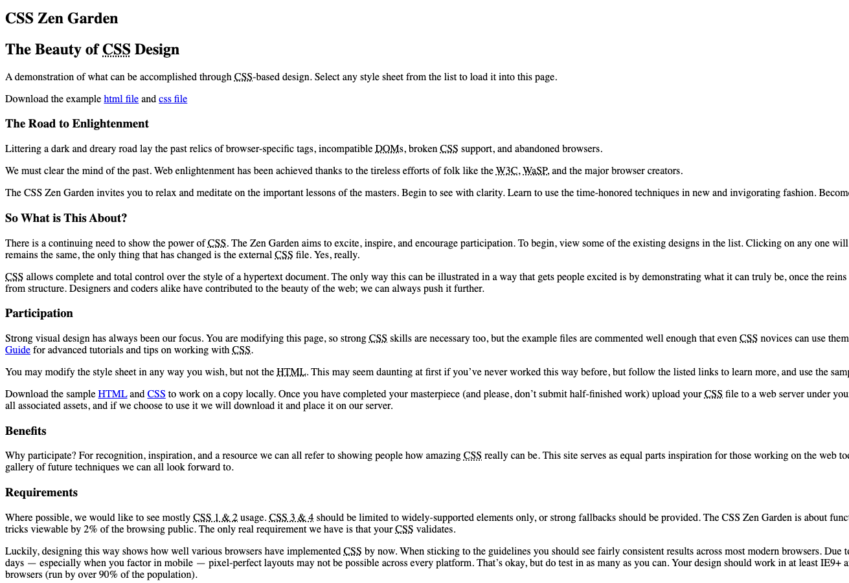
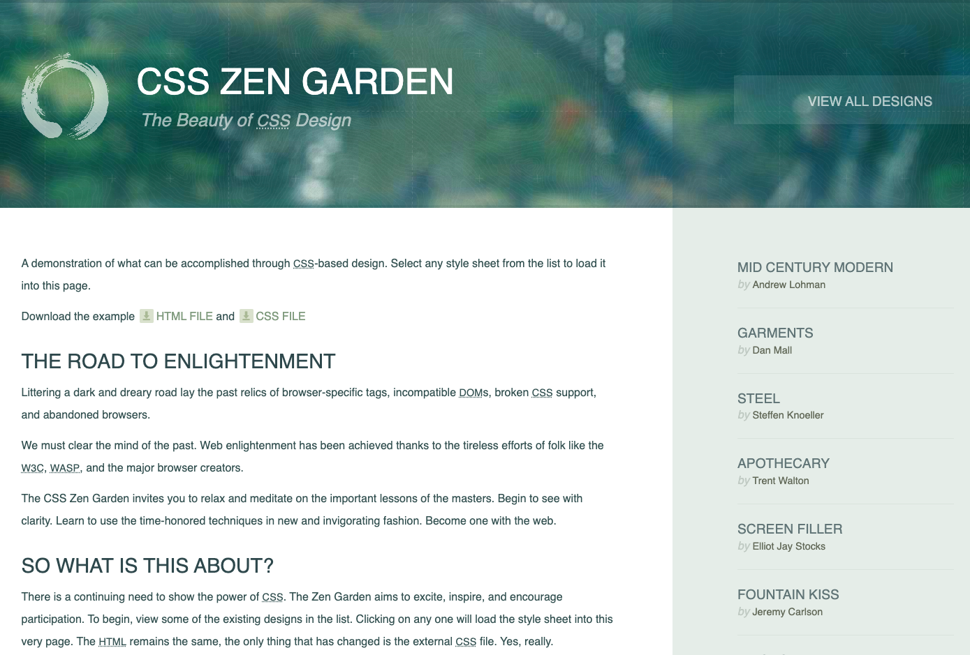
HTML Vs. CSS
Only HTML
With CSS

Slide 4
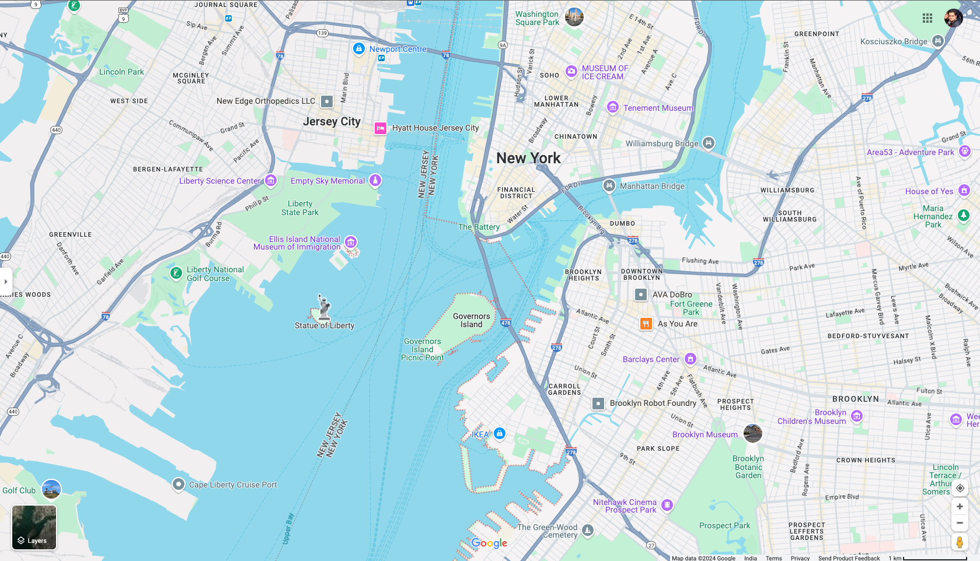
JavaScript For Dynamic Functionality
Google Maps – Example of Interactivity with JavaScript

Slide 5
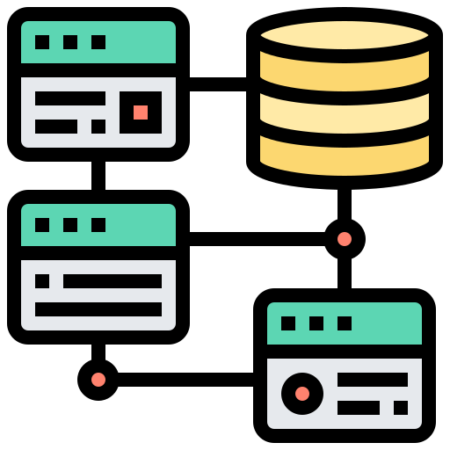
Client Side Vs Server Side
Client Side Code | Front-End
Sever Side Code | Backend-End
Client-side code runs in the user's web browser, handling the presentation and interaction of web pages using languages like HTML, CSS, and JavaScript.
Server-side code runs on a web server, processing requests, accessing databases, and generating dynamic content before sending it to the client.

